Slide 1

Embrace Digital Art
Group7
XiLong, JinhaoGuo, HaoranLi
Humboldt-Universität zu Berlin
Digital Economy& Data Analysis
Professor WolfGang
July 14th, 2025

Slide 2
OurWork for HW4:
1.Create rotation plot for slide 17 in SVM.
2.Do SVM on your data of choice.

Slide 3
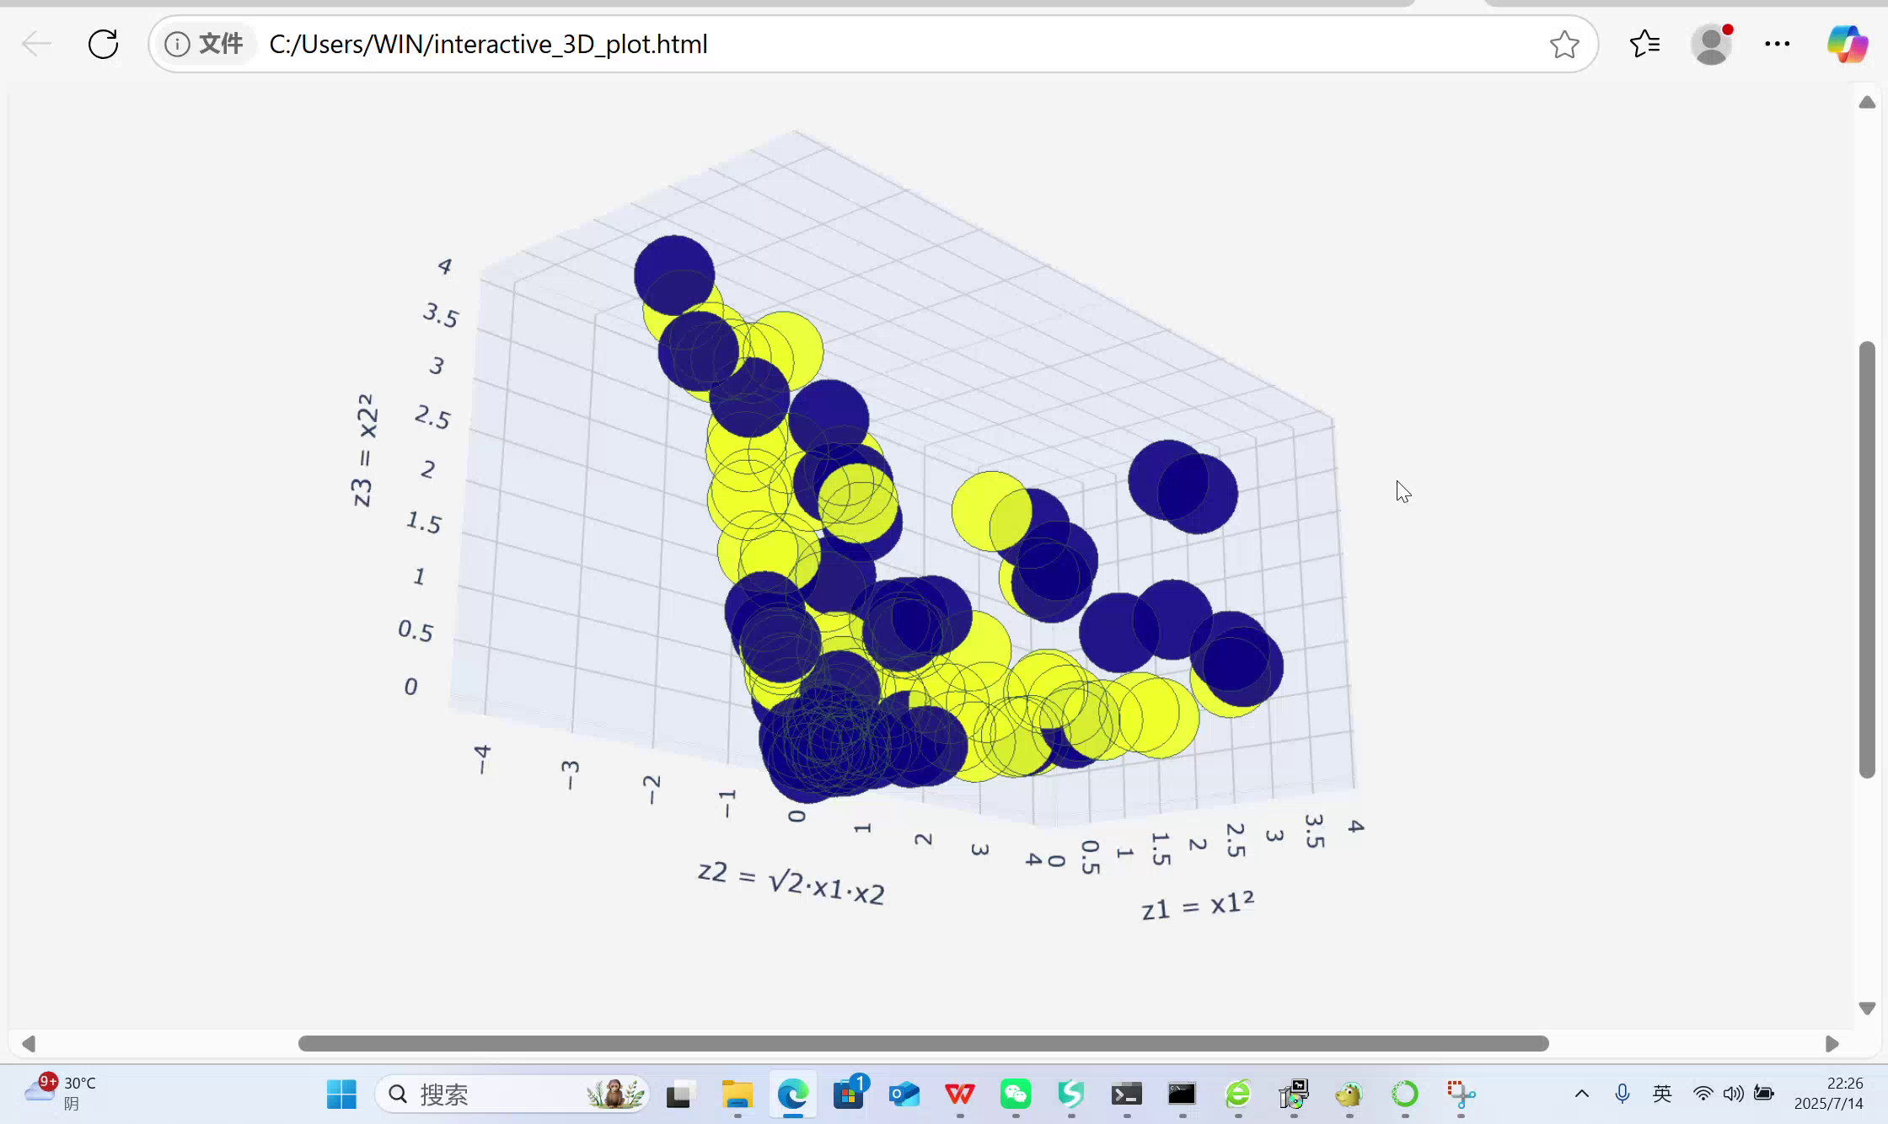
Part1.Create a rotation plot for slide 17 in SVM.

Slide 4
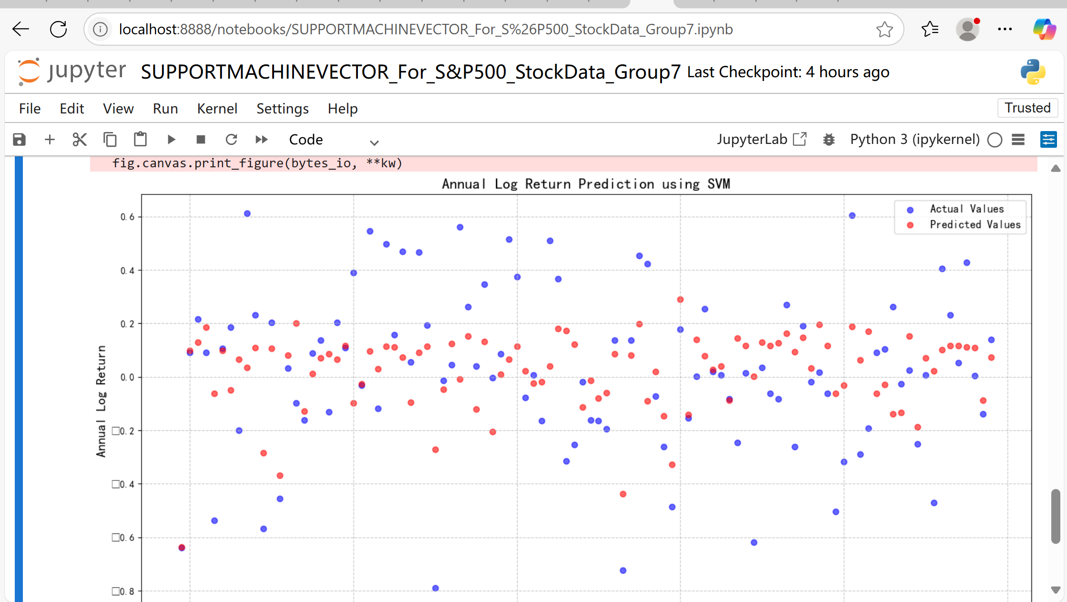
Part2(a).Do SVM on dataset; “sp500_dataset.csv” from gitHub
Target variable selection:
To predict 'annual_return_log'
This makes more sense giventhedataset contains financial metrics rather than daily prices

Slide 5
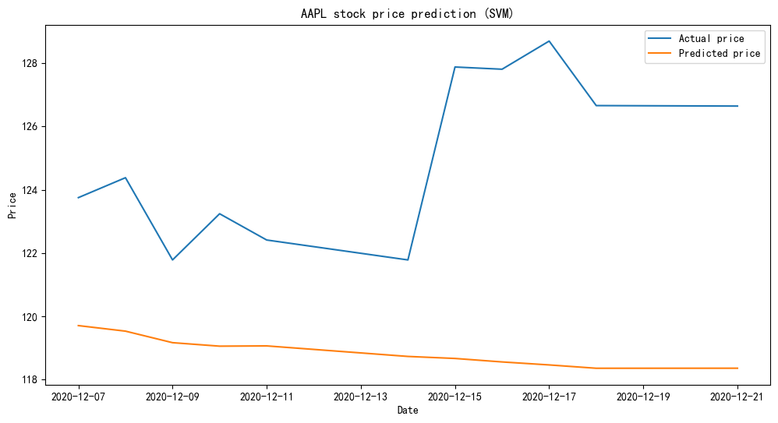
Part2(b).Do SVM on dataset; “sp500_joined_closes.csv” from gitHub

Slide 6
Attached files.

Slide 7

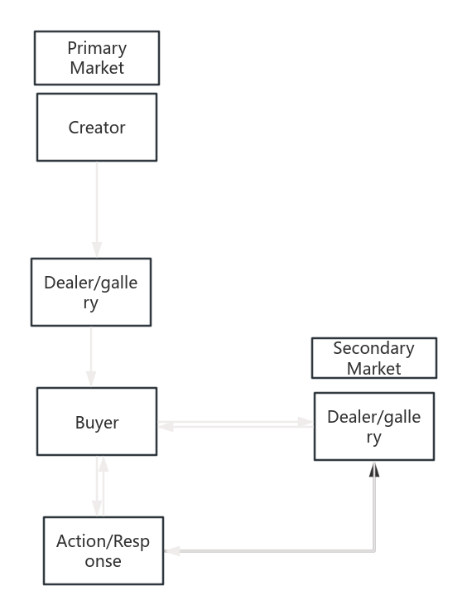
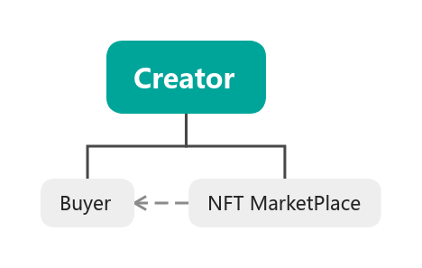
Thanks for watching!
The mindmap of Selling Process in Primary(Second) Market.

